Slide 1
Create the following chart on a sheet of paper and fill in each section appropriately:
Country | Dictator | Ideology (government style)
Germany
Italy
3. Japan
4. Russia
After reviewing each country’s ideology, what did all of these countries have in common?

Slide 2
WORLD WAR II

Slide 3
DICTATORS THREATEN WORLD PEACE
Following WWI, many democracies were established in European countries. Over time, these democracies will fall to the hands of ruthless totalitarian rulers. Totalitarianism- government that has complete control over its citizens, individuals have no rights, and the govt. suppresses all opposition.
Totalitarian states were controlled by a dictator. The following were totalitarian nations and their leaders:
Germany: Adolf Hitler
Soviet Union (Russia): Joseph Stalin
Italy: Benito Mussolini
Japan: Hideki Tojo and Emperor Hirohito
Totalitarian governments rose in Europe for two main reasons:
Economic problems that plagued much of the world
Continued anger and resentment over the Treaty of Versailles

Slide 4
These totalitarian states, as well as Japan in the Pacific, believed the answer to all their problems was an aggressive campaign to conquer and command. Each of these nations developed a plan of conquest in their respective regions.
The U.S. responded to these acts of aggression with extreme caution.
The U.S. and its citizens were not interested in becoming involved in another European or even Pacific conflict.
As a result, the U.S. passed the Neutrality Acts of 1937 (and ’39 ). This established a policy known as the “Cash and Carry Policy.” They did the following:
Outlawed arms sales or loans to nations at war
Extended the above ban to nations engaged in civil wars (done in response to the Spanish Civil War being fought)
Continued aggression in Europe and the Sept. 1, 1939, invasion of Poland by Germany brought the start of WWII in Europe.

Slide 5
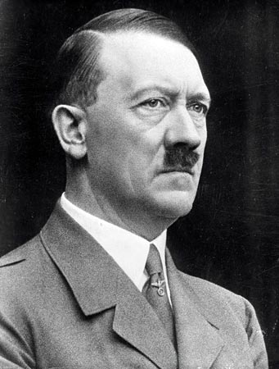
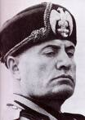
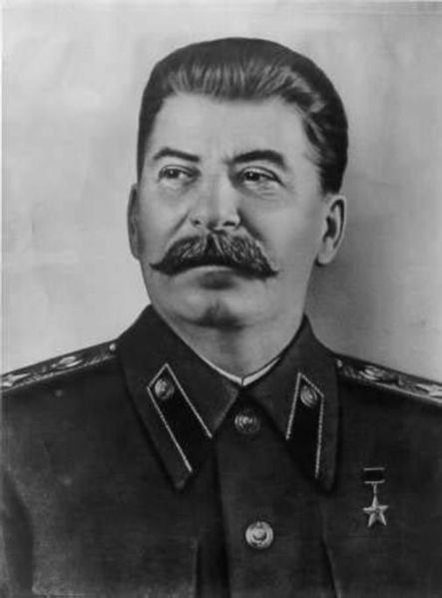
The combatants:
Hitler and Germany were part of the Axis Powers. This was a military alliance between Japan, Italy, and Germany (JIG).
They will be against the Allied Powers which consisted of France and Great Britain. Eventually, the Soviet Union and the U.S. will join the Allies.

Slide 6
WORLD WAR II

Slide 7
AMERICA MOVES TOWARD WAR
From the mid 1930’s until our entry into WWII in 1941, President Roosevelt and the U.S. held to neutrality. This policy changed over time due to President Roosevelt having to walk a fine line between helping the Allied nations while maintaining a positive relationship with those Americans supporting isolationism.
Examples of the U.S. aiding G.B. and the U.S.S.R.
Cash and carry policy- warring nations could buy U.S. arms with cash and had to transport them themselves
Destroyers for bases deal- U.S. traded 50 of our old destroyers to G.B. in return for leases on British military bases in Newfoundland and the Caribbean
Lend-Lease Act- the U.S. would lend or lease arms and other war supplies “to any country whose defense was vital to the United States”

Slide 8
The U.S. had essentially become what President Roosevelt called the “arsenal of democracy”. He referred to the U.S. as this b/c we had the means and resources to mass produce the needed war supplies for Great Britain and the Soviet Union.
In late 1941, President Roosevelt and British Prime Minister Winston Churchill met aboard the USS Augusta and agreed upon what became known as the Atlantic Charter- a statement of war goals that pledged the U.S.’s help in every way short of a war declaration.
It was similar to President Wilson’s 14 Points in regard to the establishing an enduring post-war peace.

Slide 9
The U.S. will be plunged into full scale war on December 7, 1941. Angry over an oil embargo imposed by the U.S., Japan’s Hideki Tojo launched a surprise attack against the U.S. Pacific fleet at Pearl Harbor, Hawaii.
The Japanese killed over 2,400 Americans and wounded almost 1,200. They also destroyed over 300 aircraft and sunk/damaged 21 ships. Fortunately, Japan’s main targets (3 aircraft carriers) were out to sea and avoided the attack.

Slide 10
PEARL HARBOR, 1941

Slide 11
JAPANESE ATTACK PLANS

Slide 17
America’s Response
The next day, President Roosevelt proclaimed Dec. 7th a “day which will live in infamy” and asked Congress for a declaration of war against Japan. They approved the declaration on Dec. 9th.
2 days later, Germany and Italy (Japan’s allies) declared war and the U.S. was now in a two theater (Europe/Pacific) world war.

Slide 18
WORLD WAR II

Slide 19
MOBILIZING FOR DEFENSE
The U.S. had been supplying European nations since the start of the war. This helped to bring us out of the Great Depression as it stimulated our economy. Additionally, the government expanded to help push the war effort.
Wartime agencies and projects:
War Production Board (WPB)- converted factories/industries from peacetime to wartime production as well as rationing/distributing important resources to industries (car factories to military machinery factories and gas rationing)
Office of Price Administration (OPA)- fought wartime inflation and were in charge of all wartime food rationing
Office of Scientific Research and Development (OSRD)--responsible for new inventions and innovations during the war.
Such as radar, sonar, penicillin, and pesticides such as DDT
Manhattan Project- codename for the U.S. atomic weapons research project conducted for the military

Slide 20
MOBILIZING FOR DEFENSE
The U.S. had passed the Selective Training and Service Act in 1940 to bolster our military. This was expanded following Pearl Harbor and by early 1942 the U.S. had 15 million volunteer/drafted soldiers in the military.
U.S. minority wartime contributions:
Women- went back to work in factories/industries in great numbers and were vital to the war effort; also served in non-combat positions in the military like nurses, drivers, and even pilots
African, Hispanic, Native, and Asian Americans- they all served with great honor even though they were often segregated and discrimination was widespread (one of the most famous minority units was the Tuskegee Airmen comprised of African-American pilots); also worked in factories/industries at home

Slide 24
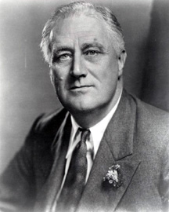
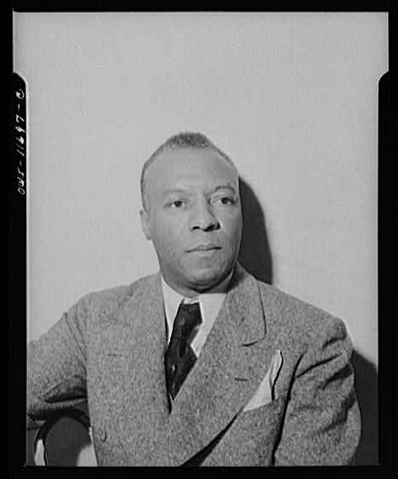
The military and workplace discrimination did not go unnoticed, particularly within ethnic groups. A. Philip Randolph organized/planned a July, 1, 1941, African-American protest march on Washington D.C. that got President Roosevelt’s attention.
This protest march was eventually cancelled by Randolph when President Roosevelt issued an executive order stating that employers and unions had to provide fair and equitable work in defense industries regardless of race, color, creed, or national origin.

Slide 25
THE HOME FRONT
One major social factor that impacted the U.S. was the mass migration of people to the north and west. African-Americans, in particular, moved north to cities for jobs.
Another situation that developed here at home was the treatment of Japanese-Americans. Following the attack on Pearl Harbor, there was a widespread fear of Japanese from coast to coast.
The U.S. govt. responded to this widespread fear by placing Japanese-Americans in internment, or relocation, camps, that were essentially prison camps.

Slide 29
The U.S. Supreme Court said that the govt. was justified in this action by saying that during times of war national security and well-being took priority over the rights of an individual in the case Korematsu v. U.S.
What previous U.S. Supreme Court decision did this mirror?

Slide 30
WORLD WAR II

Slide 31
The War in Europe
Stalin became insistent that the Allies open a second front in Europe. A plan was soon put in the works for an Allied invasion of France.
The Allied invasion of Nazi-controlled Europe (France) was called “Operation Overlord”. It took place on June 6, 1944, and was the largest land-sea-air operation in army history took place. Three million Allied soldiers and mountains of equipment stormed Normandy beach in France. This was called D-Day.
The Allies had secured a foothold in Europe and successfully opened a second front against Nazi Germany.

Slide 32
D-DAY INVASION MAP

Slide 33
Hitler’s last offensive of the war began in December, 1944. This became known as the Battle of the Bulge.
The Germans suffered heavy casualties and eventually retreated.
The Allies met in early-1945 at the Yalta Conference to discuss plans for the time following Germany’s defeat. At Yalta, Stalin agreed to:
Help in the Pacific once Hitler was defeated
Allow free elections in Eastern Europe following the war’s conclusion
Create an international peace keeping body, the United Nations

Slide 34
THE HOLOCAUST
As the Allies approached Berlin, they were faced with the fact that the horrid rumors about German atrocities were true. Hitler’s Final Solution and was based largely on the concept of genocide- the deliberate and systematic killing of an entire population.
His plan morphed from execution-style murders to the rounding up of Jews and placing them in concentration camps. Once there, some were put to work while others were executed. Bodies were either cremated or buried in mass graves.
Some were even used in horrific medical experiments and research projects.
All total, the Jews suffered six million deaths at the hands of Hitler and Nazi Germany.

Slide 37
NAZI CONCENTRATION CAMPS

Slide 38
EXTERMINATION CAMP AUSCHWITZ

Slide 39
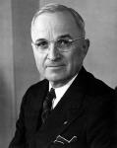
On April 30th,1945, Hitler committed suicide in his Berlin bunker. On May 8th, (VE Day-Victory in Europe Day), the war ended with Germany’s surrender.
Sadly, President Roosevelt never saw this. He died of a stroke in April. His VP, Harry Truman, became our nation’s 33rd president.

Slide 40
THE WAR IN THE PACIFIC
The Japanese are going to continue their advance in the Pacific. In May, 1942, the Japanese invasion of Australia was stopped and turned back by the American/Australian navies.
In early June, 1942, the U.S. successfully stopped an attempt by the Japanese to take Midway Island which lies northwest of Hawaii. This was a/THE crucial turning point in the war.
With the victory at Midway, the U.S. began a strategy of island hopping- capturing some Japanese held island while bypassing others in order to establish bases from which to attack Japan.
Clearing out islands was a slow, high casualty operation for the U.S. As we drew closer to Japan, President Truman had to make a huge decision in regard to directly attacking Japan.

Slide 41
JAPANESE KAMIKAZE

Slide 44
As the U.S. got within striking distance of Japan, President Truman had to decide between a conventional invasion of Japan or using our newly developed atomic weapons. There were pros and cons to each:
A conventional invasion would keep our atomic weapons a secret, but would cost a million plus lives in conquering Japan
The atomic weapons would spare those American lives and quickly end the war, but inflict horrific damage on Japanese cities and civilians
Ultimately, President Truman choose to drop the atomic bombs. On August 6, 1945, the city of Hiroshima was leveled by an atomic bomb. The Japanese refused to surrender and on August 9, 1945, a second atomic bomb was dropped on Nagasaki. Emperor Hirohito, horrified by the destruction, surrendered to the U.S.
On September 2, 1945, formal surrender ceremonies were held and WWII had come to an end.

Slide 45
HIROSHIMA PHOTOS

Slide 50
JAPANESE SURRENDER ON BOARD THE USS MISSOURI

Slide 53
Legacies of the war:
A new peace keeping organization (United Nations) would be created and operated to avoid future conflicts
One thing that was very fortunate for the U.S. was that our country suffered very little physical damage from both WWI and WWII. Our location and natural geographic protection (vast oceans) were the main reasons fighting never spread to mainland soil.
There was also a movement to help our returning soldiers readjust to society and have better educational and economic opportunities. This came in the form of the GI Bill of Rights. The GI Bill of Rights did the following:
Provided free higher education and/or job training for veterans
Provided low interest loans for buying homes or farms or starting new businesses

