Slide 1
Unit 3 Chapters 10 & 11
The Industrial Revolution Begins

Slide 2
Opening Question
Thinking about the American and French Revolutions, what do you think might happen during the Industrial Revolution?
Is this the Industrial Revolution?

Slide 3
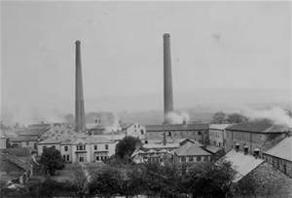
Section 1: Dawn of the Industrial Age
The Industrial Revolution was the replacing of human/animal power with new sources of power. Economies began to shift from farming to manufacturing (creating products in factories).

Slide 4
Where did it begin?
2. The Industrial Revolution began in Great Britain.
Think back to Unit 1…Why was Great Britain a world power at the time?

Slide 5
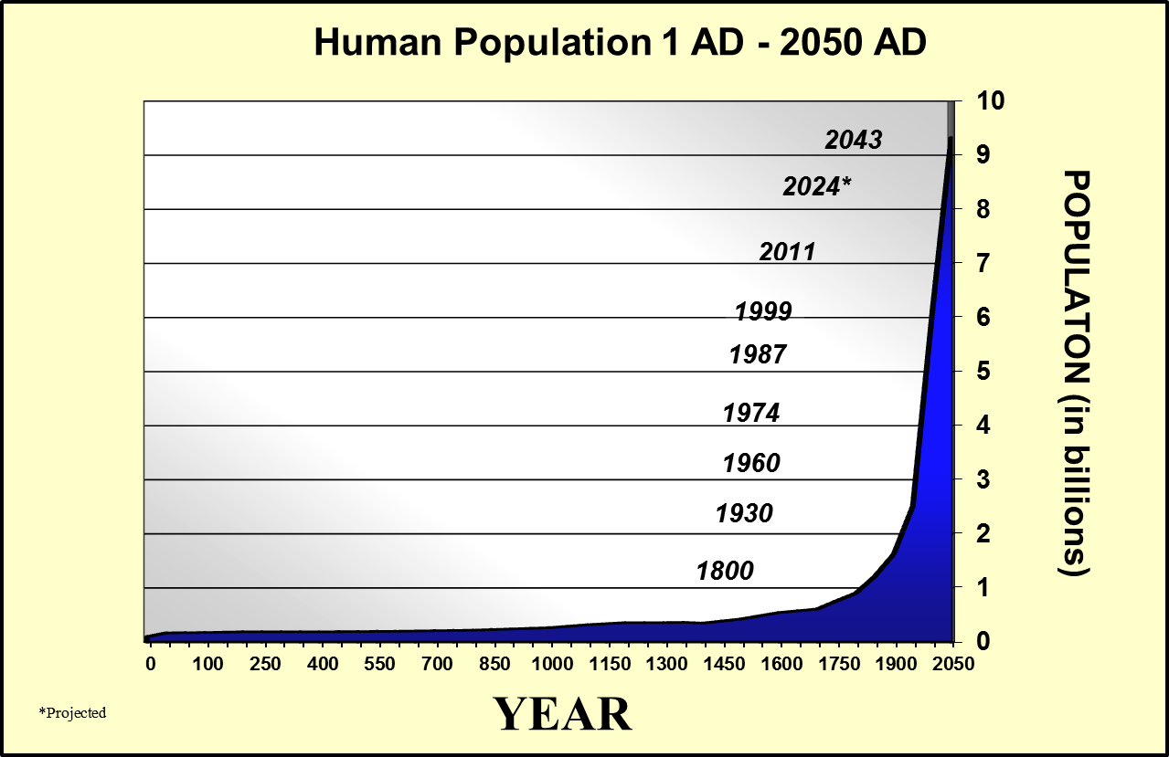
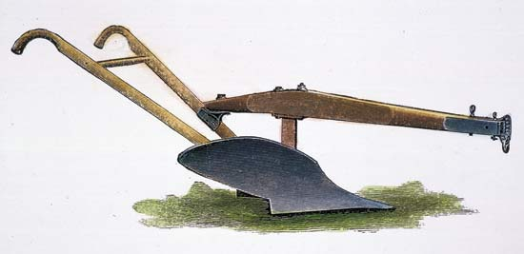
5 Factors that Contributed to the IR
3a. The Agricultural Revolution --- the creation of new equipment (John Deere), the introduction of new crops (potato/corn), and other factors meant that more people could be fed for less.
4. This, along with new medicine and advances in science, helped spark a population boom.

Slide 6
5 factors
3b. The growth in population provided labor (workers) for the new factories.
When Parliament passed (5.) enclosure movement laws (laws that allowed large landowners to fence off land shared by peasants), the peasants were forced to move to the city and work in the factories.

Slide 7
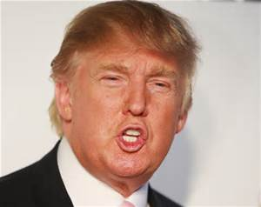
5 factors
3c. Britain had lots of money to invest, also known as (7.) capital, in new machines and factories.
8. This gave entrepreneurs, a person who creates new businesses, the opportunity to find new ways to make profit.

Slide 8
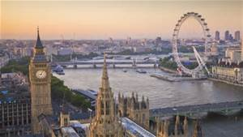
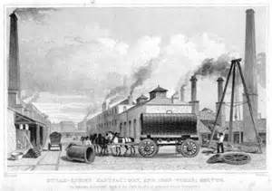
5 factors
3d. Britain had lots of natural resources.
9. Rivers provided water power, coal provided steam power, and iron ore provided material to make new machines and factories.
River Thames

Slide 9
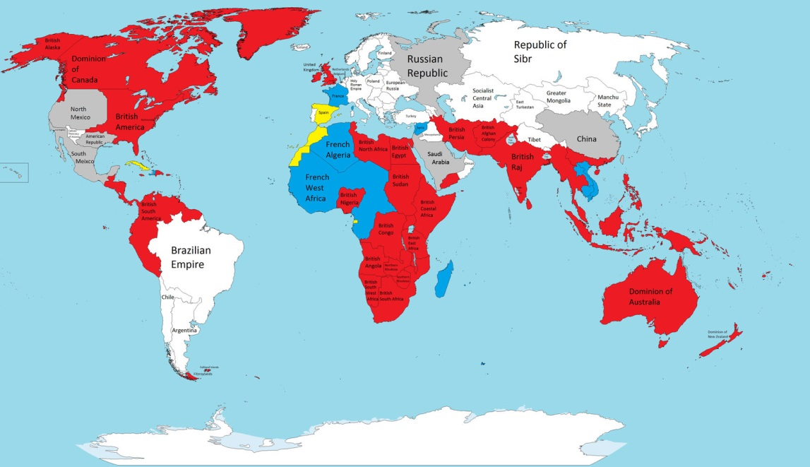
5 factors
3e. Britain had a large supply of markets (places to sell their goods). Britain had many colonies and domestic (people at home) markets increased as people made more money.

Slide 10
Cottage Industries
10. A cottage industry was a two step process that people did in their rural homes, also called cottages.
Step 1 – Spinners made cotton thread from raw cotton
Step 2 – Weavers turned the thread into cloth on looms.
These cottage industries were replaced by James Hargreave’s spinning jenny and Edumund Cartwright’s water-powered loom.

Slide 11
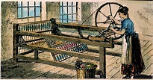
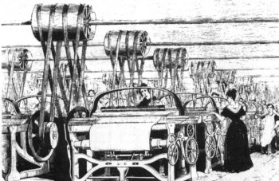
The spinning jenny and water-powered loom

Slide 12
Essential Question --- Day 1
What was the significance of the Agricultural Revolution in Great Britain?
Why did the Industrial Revolution start in Great Britain?

Slide 13
Opening Question
How has new technology shaped the way the world has worked since you were born?

Slide 14
New Technology
11. James Hargreaves – invented the Spinning Jenny
Edward Loom – invented the water powered loom (hydro-powered)
James Watt - improved the steam powered engine (coal-powered)***
Henry Cort – created a better quality of iron through a process called puddling.
Richard Trevithick – invented the first steam locomotive (train)

Slide 15
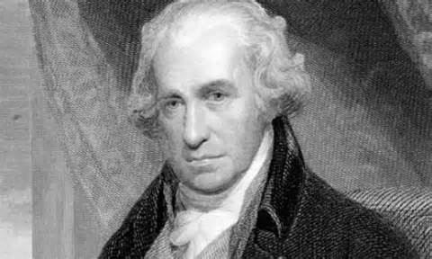
The First Factories
12. The first factories were built along the water because they depended on hydropower. However, when James Watt improved the steam engine, factories could use coal for power instead of water.

Slide 16
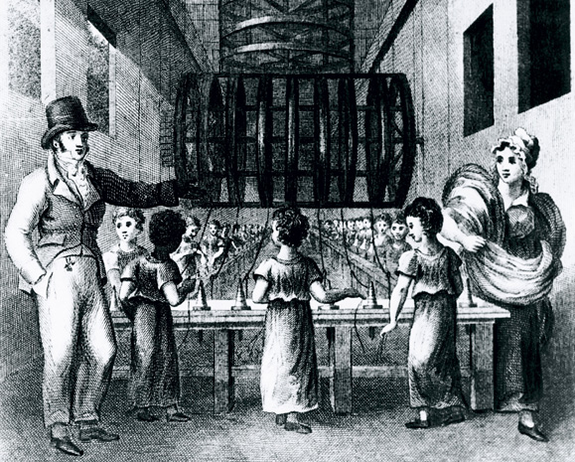
Early Factory Workers
13. Early factory workers came from rural areas where they had been kicked off of the land. Many women and children also worked in the factories.

Slide 17
Working Conditions
14.Working conditions in factories were much worse than they had been on farms:
People were forced to work long hours (12-16 hours, six days a week)
No job security and bosses who abused workers (especially children and women) physically
No minimum wage
People were often fired for small infractions

Slide 18
The Steam Locomotive
15. The Steam Locomotive transformed the British economy by creating a cycle:
Building railroads provided many new jobs
Less expensive transportation made goods cost less, meaning a bigger market.
More sales meant more need for factories
More factories meant more profit for factory owners
More profits meant they could build more railroads and more factories
IT GREW THEIR ECONOMY TREMENDOUSLY!

Slide 19
Great Britain’s Secret
16. Great Britain enjoyed the fact that they were the leaders of the I.R. and passed laws to prevent the exporting of inventions in hopes to keep the I.R. from spreading to other nations.

Slide 20
More Nations Industrialize
17. Belgium, France, and Germany soon followed Great Britain in industrializing their countries.
(Remember Napoleon building new industries, roads, and canals)

Slide 21
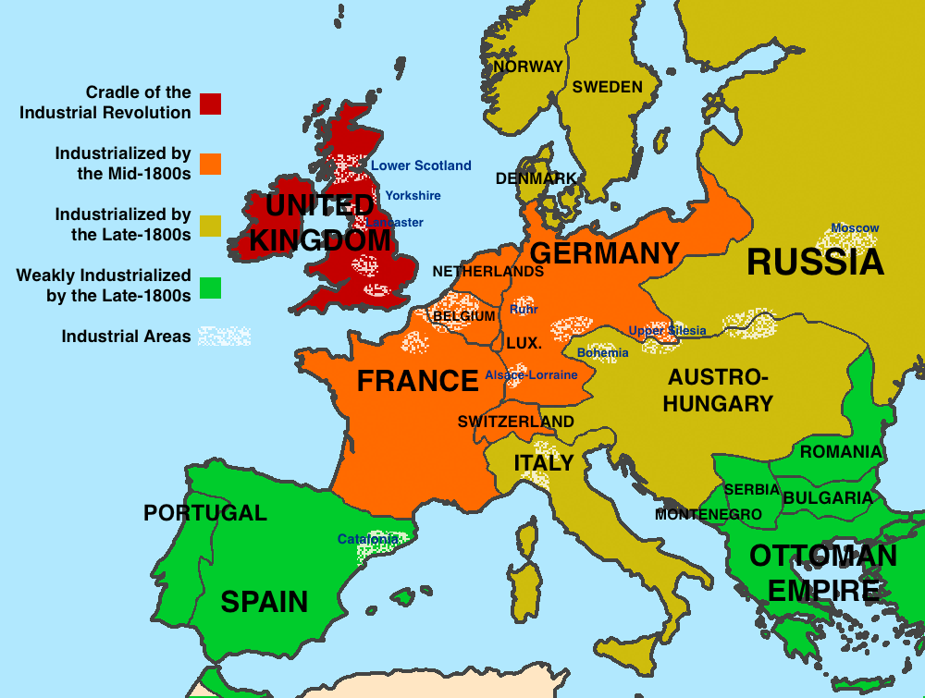

Slide 22
5 Factors for Industrialization
18. The 5 factors that any nations that is industrializing must have are:
A. Land (natural resources)
B. Labor (workers)
C. Capital (money and equipment)
D. Technology
E. Stable Government (NO REVOLUTIONS!)

Slide 23
Transportation Revolution
19. The Industrial Revolution led to the transportation revolution.
20. A. Turnpikes – privately built roads that charged travelers a fee to use
B. Canals were dug to link rivers
C. Bridges and Harbors were built
D. The Steam Locomotive was introduced
E. Steam power was also used to power boats.

Slide 24
Essential Question
What factors fed the spread of industrialization in Europe and North America?

Slide 25
Opening Question
Would you have rather lived before the Industrial Revolution or during the Industrial Revolution?
What are the benefits of working on a farm? What are the benefits of working in a factory?

Slide 26
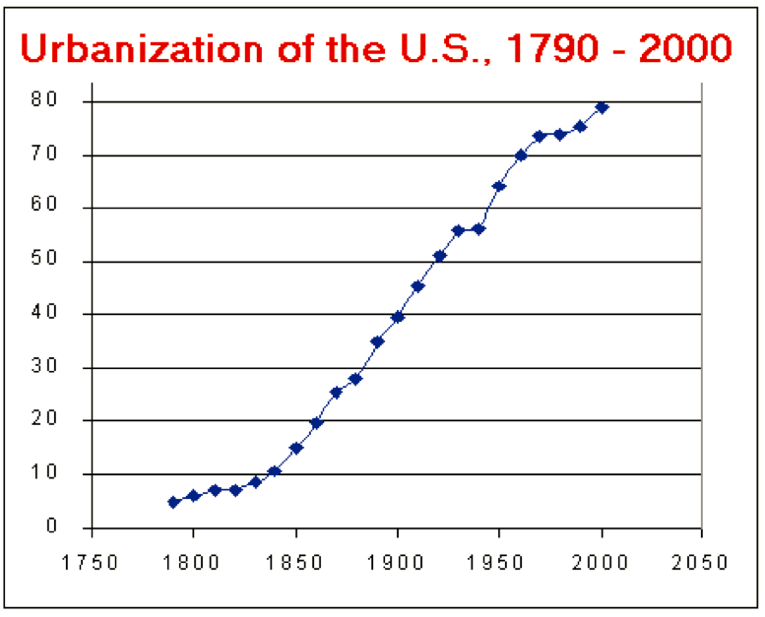
Urbanization
21. As jobs increasingly moved to the factories, people increasingly moved to the cities. People moving from rural areas to urban areas is called urbanization.

Slide 27
Push-Pull Factors
22. The lack of jobs and opportunities along with bad conditions at home pushed people from home to the cities. Factory jobs and the chance for a new life pulled people to the cities.

Slide 28
Emerging Social Classes
23. Two new social classes emerged during the Industrial Revolution, the industrial working class (proletariat) and the industrial middle class (different than bourgeoisie).

Slide 29
Industrial Capitalism
24. Industrial Capitalism was a shift from economies based on trade to economies based on manufacturing and industry. The goal of any kind of capitalism is to make a profit.

Slide 30
Factory Life
25. Life was bad for the factory workers.
Exhausted workers were often injured
Sick or injured workers were often fired
26. Women were hired, which caused neglect of “normal” home duties
26. Children/orphans were often hired due to their small size

Slide 31
Rise of Socialism
27. Socialism is a type of economic system where society (government) owns the means of productions (factories, land, etc…)
Many workers and others believed that since the workers provided the labor, they should own the factories.

Slide 32
Essential Questions
What was the social impact of industrialization in Europe?
Why do you think the working conditions during the Industrial Revolution led some to argue for socialism?

Slide 33
Chapter 11 Section 1
The Second Industrial Revolution
Thinking back to the French Revolution, are the results of Revolution positive or negative?

Slide 34
Pioneers and Entrepreneurs
28. Henry Bessemer – patented a new process for making high-quality steel called the Bessemer Process.
Thomas Edison – created the incandescent light-bulb
Wright brothers – responsible for the first flight in Kitty Hawk, North Carolina
Henry Ford – (yes, the founder of Ford) he is responsible for the assembly line

Slide 35
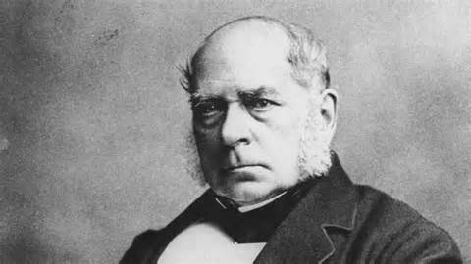
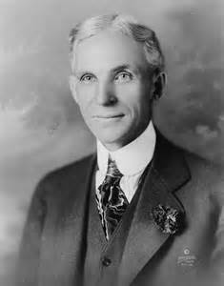
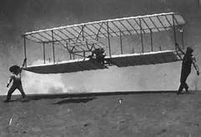
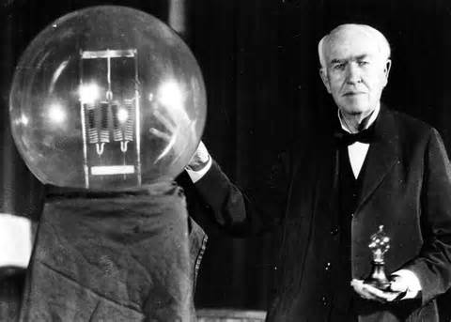

Slide 36
What about the other countries?
29. Other countries that did not industrialize, like Spain, Portugal, and Russia, provided the industrial nations with food and raw materials.
A. They did not industrialize because these nations were less advanced politically and technologically.

Slide 37
World Economy
30. The second Industrial Revolution and the growth of transportation created a new world economy.
A. Industrialized countries were receiving raw material from other countries and in return providing them with finished goods. (The industrialized nations were the winners in this deal!)

Slide 38
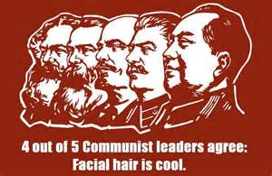
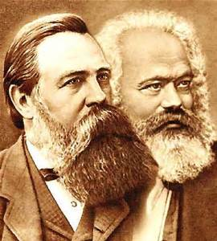
The Communist Manifesto
31. Karl Marx (with the help of Frederick Ingles) wrote The Communist Manifesto.

Slide 39
Communism
32. Since Marx wrote the book, he is rightfully known as the “Father of Communism.”
33. Communism is a political philosophy where the government owns all of the factors of production (Land and Capital). It is linked directly with the economic idea of socialism.

Slide 40
Class Struggles (not math class)
34. Marx believed that there was a struggle between the bourgeoisies (industrial middle class who owned the factories) and the proletariat (industrial working class that owned nothing)

Slide 41
Unions
35. A trade union, or labor union, is when workers organize to demand certain rights (fair wages, shorter working hours, safer conditions, etc…)

Slide 42
Unions
36. They achieved this through strikes, negotiations, and other methods. At first they were viewed as radical and strikes were illegal. However, these groups slowly gained power and won more rights for the workers.
Teachers recently went on strike in Seattle, meaning students had nearly TWO WEEKS off of school!

Slide 43
Essential Question
How is the political idea of communism linked with the economic idea of socialism? How did conditions during the second IR contribute to the rise of communism?

Slide 44
Chapter 11 Section 2
Do women and men have complete equality in society today?

Slide 45
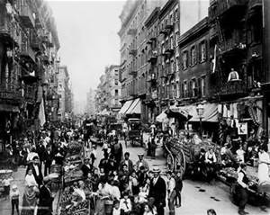
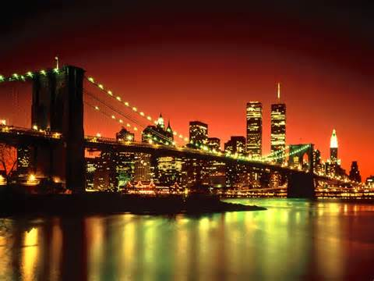
City Life
37. As the population of cities continued to grow, conditions got worse. Sewage built up in the streets, housing was extremely crowed, and crime and disease were rampant.

Slide 46
City Improvements
37A. Urban reformers called for improvements in sanitation and public health. Running water and a sewage system was implemented in most cities.

Slide 47
Social Classes (38)
New Elite | Middle Class | Working Class
Used to be only the aristocracy | Used to be a small middle class | Used to be landholding peasants and sharecroppers
Now it is the aristocracy and wealthy industrialists | Professionals - Lawyers, Doctors, and Engineers | Now includes Urban workers and domestic servants
They are the leaders of the military and government | Lower Middle Class – Shopkeepers, traders, and wealthy farmers | Conditions are SLOWLY getting better for the lower class
 | White Collar Workers – salespeople, secretaries, and telephone operators
 | Shared a lifestyle that centered around outward appearance

Slide 48
Women in the IR
39./39A. There were not enough men to fill the jobs from the second IR, so women began entering the workforce. Also, the expansion of government’s role increased jobs for women in education and healthcare.

Slide 49
Feminism
40. As women gained more independence, feminism began to grow. Feminism is the movement for women’s rights. It’s main goal was social equality based on the idea of Natural Rights. It began as a push for the right of women to hold property.
41. However, it also included women’s suffrage. Suffrage is the right to vote.

Slide 50
The Fight for Women’s Suffrage
42. Even after the formation of many societies and groups, it will not be until after World War I that many countries give women the right to vote.

Slide 51
Public Education
43. Public education began to grow for three reasons:
The factories needed better trained and educated workers
As democracy grew, countries needed a literate voting base.
It allowed countries to instill nationalism in their citizens.

Slide 52
Essential Question
How did the second industrial revolution lead to the development of different social causes in the twentieth century?

