Slide 1
UNITED STATES HISTORY
LYNDON JOHNSON, VIETNAM, and
RICHARD NIXON

Slide 2
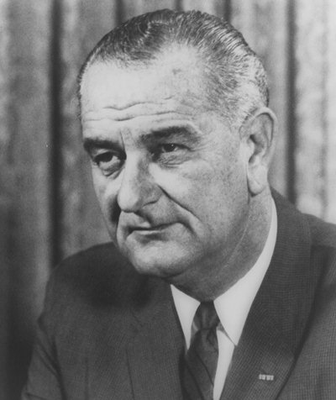
THE GREAT SOCIETY
Following the assassination of President Kennedy, Vice President Lyndon B. Johnson (LBJ) assumed the Presidency.
Johnson will continue many of the ideas and reforms Kennedy had started and wanted to start for the country. LBJ outlined his complete social plan for America in what he called the Great Society- Johnson’s plan to change America by helping the poor and poverty stricken with government backed welfare programs.
Many issues will be addressed in American society through the Great Society, but he, like JFK will focus on:
Civil Rights
Anti-Poverty legislation

Slide 3
Civil Rights Issues
Civil Rights Act of 1964- prohibited discrimination in public places; desegregated public facilities.
Voting Rights Act 1965- ended literacy tests as a voting requirement and allowed for federal monitoring of voter registration
24th Amendment- abolished the poll tax in federal elections
Immigration Act 1964- ended immigration quotas based on nationality
Civil Rights Act of 1968- prohibited discrimination in housing

Slide 4
In early 1964, President Johnson will declare “unconditional war on poverty in America” to help the lower classes and poverty stricken. Some of these anti-poverty programs were:
Economic Opportunity Act (EOA)- a bill containing a number of antipoverty measures; the three most important programs were:
Head Start- provides a pre-K education to underprivileged citizens
VISTA(Volunteers in Service to America)-a Peace Corps for the U.S.
Job Corps-provided job training to citizens
Tax Relief Act-provided for income tax cuts ($10 billion total)
Medicare Act- established the Medicare program (healthcare for old people) and Medicaid (healthcare for the underprivileged)
Department of Housing and Urban Development (HUD)- formed to administer and oversee federal housing projects (helps to provide affordable housing)

Slide 5
Johnson’s Great Society is often compared to Progressive Movement programs and Roosevelt’s New Deal.
All of these programs provided government aid and assistance in society and made the government a bigger part of the lives of citizens.
What effect did it have on government spending?

Slide 6
The Warren Court
The U.S. Supreme Court was headed by Chief Justice Earl Warren during the 1960s, and the Warren Court made numerous important decisions.
Mapp v. Ohio- evidence obtained illegally may not be used at trial.
Gideon v. Wainwright-required criminal courts to provide attorneys for defendants if needed.
Escobedo v. Illinois-criminal suspects had the right to an attorney during questioning.
Miranda v. Arizona- all suspects had to be read their rights before being questioned
Many of these decisions were controversial and not well-liked by the citizens of the U.S., but all of the decisions expanded___________________________.
rights of the accused

Slide 7
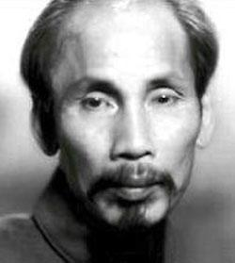
MOVING TOWARD CONFLICT
Vietnam background info:
France controlled Indochina (Vietnam, Cambodia, and Laos) prior to WWII
Japan controlled it during WWII
France (with U.S. support) came to reclaim it after WWII ended, but they were met with great resistance from the Vietminh (Vietnamese Communists) led by Ho Chi Minh
French will be defeated for good in 1954 at Dien Bien Phu
When the French left Vietnam, Eisenhower felt that containing communism was all that mattered. He then spoke of the domino theory- countries on the brink of communism were like a row of dominos, if one falls they all fall.
The U.S. and others came up with the Geneva Accords in 1954:
Vietnam was divided along the 17th parallel with Ho Chi Minh ruling the (Communist)north and the nationalists, led by Ngo Dinh Diem, ruling the (Democratic)south.
Unifying elections would be held in 1956.

Slide 8
WORLD MAP

Slide 9
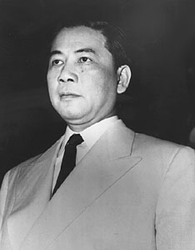
The U.S. will approach Vietnam much like we did Korea. The main objective will be to contain communism.
U.S. Presidents had funneled financial and military advisory aid into noncommunist resistance for years. This did little to slow aggressive attacks in the south by the Vietcong- South Vietnamese communists that wanted to implement communism.
Another problem was that the South Vietnamese government, led by Ngo Dinh Diem, was very corrupt, and many protested his policies. (See picture ) He also refused to hold the unifying elections in 1956.
How did the U.S. react?
Although the U.S. opposed it, Diem was assassinated. Governments and leaders that followed proved no better than Diem.
RIP

Slide 10
“Barbecue Shows”
A South Vietnamese Buddhist monk sets himself on fire (self-immolation) to protest the policies of the Diem regime. Diem’s wife, Madame Nu, creates quite a stir when she refers to these protests as “barbecue shows.”

Slide 11
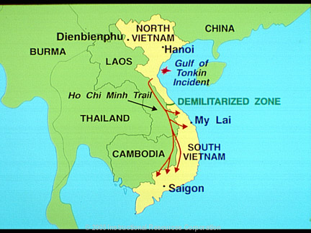
In August, 1964, a Vietnamese patrol boat fired on a U.S. naval ship in the Gulf of Tonkin. A few days later, U.S. naval ships reported being fired upon again.
President Johnson asked Congress for power to take all necessary action to combat further aggression.
Congress agreed and passed the Tonkin Gulf Resolution- it was not a declaration of war, but gave Pres. Johnson broad military powers to combat aggression with respect to Vietnam.
The U.S. began the policy of escalation (steady increase in the number of American troops involved in the fighting in Vietnam), and the Vietnam Conflict had become Americanized.

Slide 12
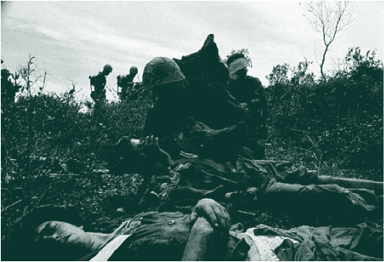
U.S. Troops in Vietnam
Escalation
Jan. 1965 – 20,000
Dec.1965 – 200,000
Jan. 1968 – 540,000
Notes:
This slide displays the increase of U.S. combat troops sent to South Vietnam and America’s policy of escalation.

Slide 13
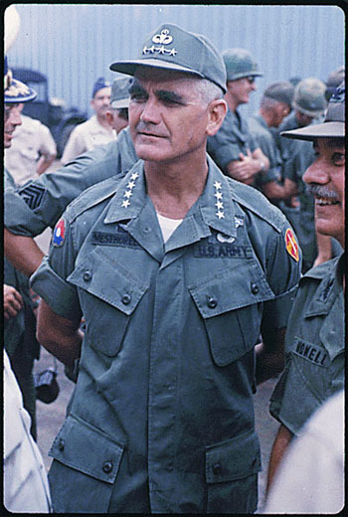
U.S. INVOLVEMENT AND ESCALATION
By the end of 1965, 200,000 U.S. troops were in Vietnam. American commander in Vietnam, General William Westmoreland, continued to request more troops
The North Vietnamese (Vietminh) and Viet Cong (South Vietnamese communists) proved to be an elusive enemy.
Not only did they blend in with the innocent civilians (VC), but they built elaborate tunnel systems from which to attack and escape.
They also used Ho Chi Minh Trail to run supplies and troops into South Vietnam. Ho Chi Minh Trail- trail that ran alongside Vietnam through neighboring Laos and Cambodia

Slide 14
VIETNAM

Slide 15
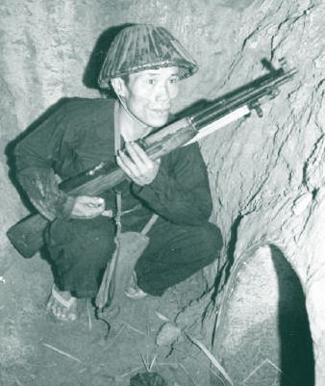
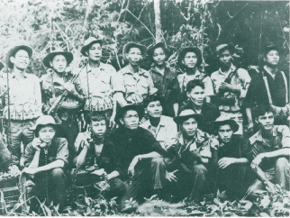
Vietnam Battle Tactics
Disguised themselves as locals
Don’t face Americans on battlefield
Retreat to tunnels
125 miles of tunnels in 1965
Landmines and booby traps
Notes:
American soldiers quickly learned that this was a different type of war. The U.S. was prepared to fight a war similar to the Korean War, but Vietnam provided numerous challenging obstacles. The Viet Cong would infiltrate villages and dress like the people living there. American troops struggled with what the enemy looked like and where to find them. The enemy could be an elderly lady in a remote village that might shoot at Americans. The Viet Cong could also retreat to miles of caves and tunnels after coming out to fight the Americans. These tactics, and more, were difficult to overcome.

Slide 16
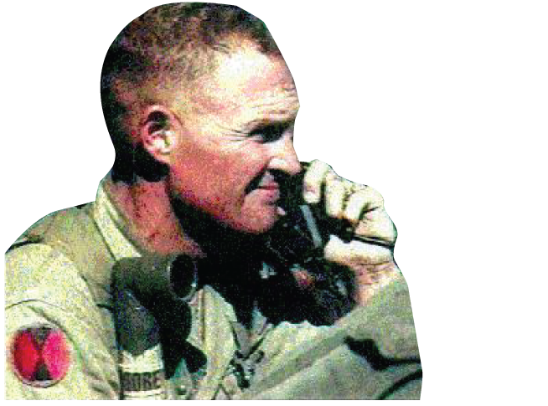
Lt. Colonel Hal Moore
“I will leave no man behind… Dead or alive. We will all come home together.” (The Valley of Death, 1965)
Notes:
Lt. Col. Hal Moore led the 1st Cavalry Division at Ia Drang Valley. He was the first man off the helicopter when the troops were brought in, and the last to leave the battlefield.

Slide 17
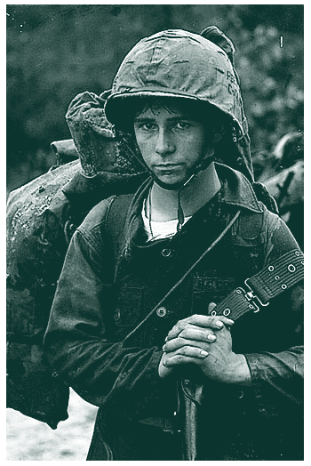
Tunnel Rats
Small American soldiers
Crawled into tunnels to fight Viet Cong
Tunnels were booby trapped
Played a valuable role in the war
Notes:
The United States responded to tunnel retreats by the Viet Cong by sending smaller American soldiers into the tunnels to blow up or flush out the enemy. These soldiers became known as Tunnel Rats. Besides putting themselves in harm’s way with the Viet Cong, they also encountered rats, snakes, scorpions, and booby traps in the tunnels.

Slide 18
Early support of the war was high in the country, but began to fade as the wounded and death toll began to rise. Television showed the war entirely different than President Johnson and commanding officers reported it. This led to the growth of what critics called a credibility gap- public distrust of the government about the war because of what they said didn’t match with what we saw on television.
By the end of 1967, the American public was split over supporting and opposing the war. Discontent would continue to grow and protests became more common.
Economic issues caused by the escalation of the war in Vietnam:
Higher inflation- value of the money declines as more is in circulation
Loss of some money being spent on Great Society programs
What effect would this loss of funding have on the effectiveness of the Great Society programs?

Slide 19
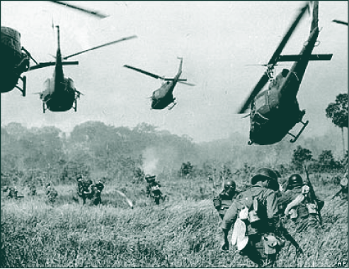
1968: A TUMULTUOUS YEAR
Major events of 1968: (5 in total)
Tet Offensive- large scale attacks by the Vietcong all over South Vietnam (over 100 cities and towns) that occurred during the Vietnamese New Year (late-Jan/early-Feb) .
This was particularly bad because Americans had been told the war was nearly over
TV showed much of this and it widened the credibility gap and caused war support to further decline
Americans saw that we couldn’t win

Slide 20
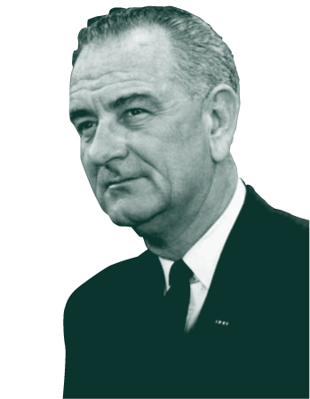
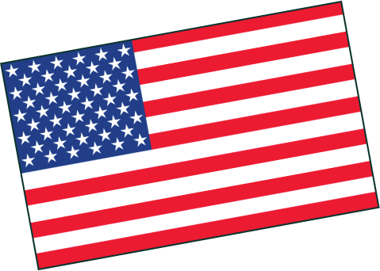
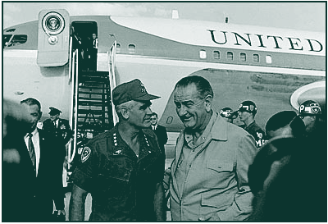
Lyndon B. Johnson
“I will not, I shall not, seek another term as your President.” (March 31, 1968)
Notes:
Greg remembers tuning into LBJ on television and listening to the American leader as he briefed the nation.

Slide 21
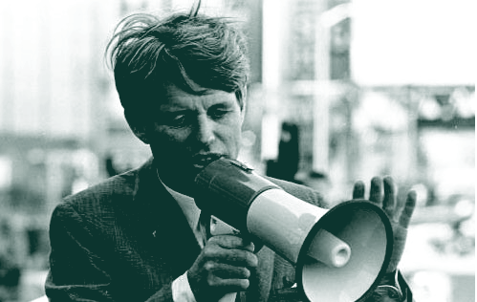
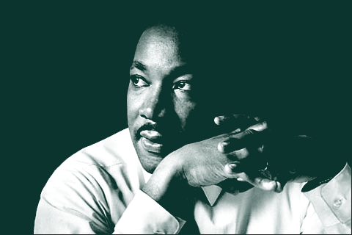
1968
MLK Jr. is assassinated in April
LBJ announces that he won’t run for re-election and Democratic Presidential front-runner Robert F. Kennedy is assassinated in June
Major riots (anti-war protests) in August at the Democratic National Convention
Notes:
1968 could be the most turbulent year in United States history. President Johnson became a victim of his own war, Martin Luther King was assassinated in Memphis in April, and Bobby Kennedy, the front-runner for the presidency, was assassinated in Los Angeles in June. Even more turmoil occurred in Chicago in August of 1968 when major riots broke out at the Democratic National Convention.

Slide 22
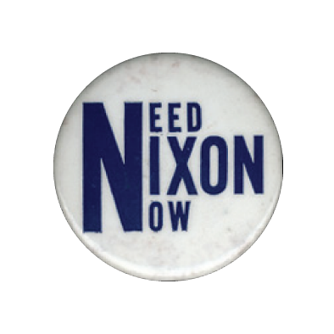
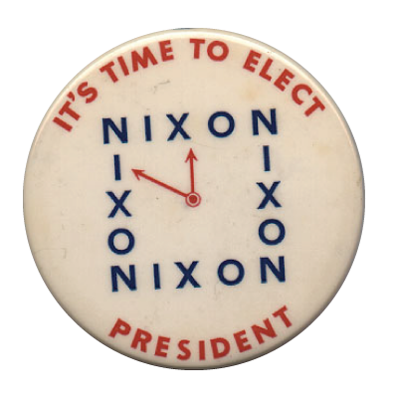
1968 Election
Nixon is elected POTUS over Hubert Humphrey (D) and George Wallace
His campaign slogan was “Peace with Honor”
18 year olds could fight, but could not vote—this would lead to the passage of the 26th Amendment
Notes:
Greg Clevenger could not vote in the 1968 election. Eighteen-year-olds were fighting and dying in Vietnam, but would not be able to legally vote until the 1972 election. Nixon campaigned on the promise that he would get the U.S. out of Vietnam, and there would be “Peace with Honor.”
Critical thinking question: Was it fair that the draft age was 18, but the voting age was 21?

Slide 23
END OF THE WAR AND ITS LEGACY
During his campaign for president, Richard Nixon vowed to pull U.S. troops out of Vietnam. He held true to his word (eventually), but it was very slow and with continued aggressive fighting.
President Nixon’s plan to accomplish withdrawal of troops from Vietnam was called Vietnamization- the South Vietnamese army would take a more active role in combat while American troops were withdrawn.
A major issue that infuriated, saddened, and sickened the American people came to light in early 1969. It further widened the credibility gap.

Slide 24
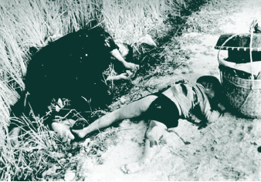
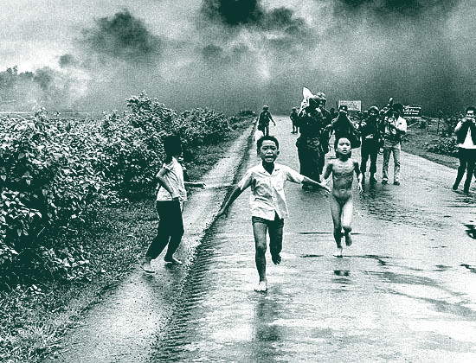
My Lai Massacre
March 16, 1968
Led by Lt. Calley
350 innocent Vietnamese women, children, and elderly were killed
The war had reached its lowest point
Notes:
A most disturbing event took place in Vietnam on March 16, 1968, at a small village called My Lai. Lt. William Calley was ordered to go to My Lai and find the Viet Cong. American soldiers, very battle weary by this time, opened fire on innocent women, children, and senior citizens, killing 350 civilians in a massacre that lasted several hours. Lt. Calley was later sentenced to 20 years “hard labor” for his role in the My Lai massacre, though he only served three and a half years of house arrest.

Slide 25
In response to the My Lai massacre and Nixon allowing the invasion of Cambodia, student protests around the country erupted. Some of these protests ended in violence and death.
Violence and death occurred on both the campuses of Kent State University in Ohio and Jackson State University in MS. National Guard troops feeling threatened and being hit by thrown objects fired into both crowds killing 6 total.
To make matters worse in the eyes of the public, information from a document called the Pentagon Papers leaked to the public. This info. showed that Pres. Johnson had made plans to enter the war even while telling the people we would stay out. Distrust of the government and it’s officials was at an all time high. The credibility gap was HUGE!
In the midst of continued growing opposition, the U.S. removed all troops in March, 1973. Our military involvement in Vietnam had ended.

Slide 26
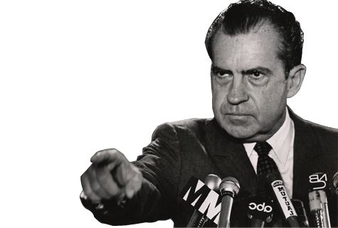
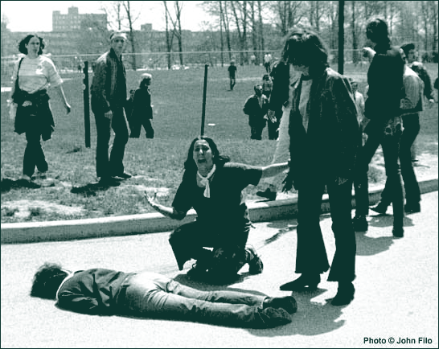
Kent State University
Demonstrations at Kent State University in 1970
Ohio National Guard is called in
Four students are killed and ten wounded
Nixon calls demonstrators “Bums”
Click here to play a sample from “Ohio”
Notes:
Kent State University in Ohio became the focus in 1970 when students once again demonstrated against U.S. interventions in Southeast Asia. The Governor of Ohio called in the National Guard to monitor the demonstration. Rocks were thrown when demonstrators were ordered to disperse; shots were fired killing four students and wounding ten. President Nixon had called the protestors “Bums.”
The song that is playing is “Ohio,” by Crosby, Stills, Nash, and Young. It is another protest song and was written directly in response to the shootings at Kent State.

Slide 27
The Vietnam Conflict/War had many great costs:
The death of over 58,000 Americans with another 300,000+ wounded.
The public’s loss of trust in the government as a whole
(credibility gap).
War Powers Act- passed by Congress in 1973 and did the following:
President must inform Congress within 48 hours of sending forces into a hostile area w/o a war declaration
Those troops can be there no more than 90 days unless the action has Congressional approval or a war declaration issued

Slide 28
PRESIDENT RICHARD NIXON

Slide 29
THE NIXON ADMINISTRATION
Richard Nixon had won the 1968 presidential election by the slimmest of margins. One method he used to gain support in the South was called the Southern Strategy-
Nixon’s attempt to gain support of conservative southern Democrats by promising to slow integration, as well as appoint a southerner to the Supreme Court.
Once in office, President Nixon was faced with a troubled economy.
Stagflation- high inflation coupled with high unemployment
Heavy dependency on foreign oil- the U.S. received much of its oil from the Middle East from a collection of countries called OPEC- Organization of Petroleum Exporting Countries
Arab OPEC nations cut off oil sales (embargo) to the U.S. in 1973 when we supported Israel against Egypt and Syria in the Yom Kippur War
When they resumed oil sales to us in 1974, oil prices had quadrupled further contributing to our high inflation dilemma

Slide 30
OPEC NATIONS WORLDWIDE

Slide 31
OPEC NATIONS-ARABIAN PENINSULA

Slide 32
To combat the growing problem of inflation, President Nixon will place a freeze on worker’s wages, business prices , and business fees for 90 days. This will ease inflation for a period of time, but did not solve the problem.
Where Nixon had troubles in the economy, his fortune was reversed when it came to foreign policy. Nixon is going to have great success and triumph in this area.
Nixon chose a more flexible approach in dealing with communist nations called détente- Nixon’s flexible policy in dealing with communist nations that focused on a willingness to negotiate and ease Cold War tensions
U.S. and Soviet Union signed the SALT I Treaty (Strategic Arms Limitation Treaty)- five year agreement limiting the number of intercontinental ballistic missiles (ICBMs) and submarine launched missiles
Continued withdrawal of U.S. soldiers from Vietnam

Slide 33
WATERGATE: NIXON’S DOWNFALL
The ultimate downfall of President Richard Nixon will come in the form of a scandal known as Watergate- the Nixon administration’s attempt to cover up a burglary of the Democratic National Committee (DNC) headquarters at the Watergate office and apartment complex in Washington, DC
Two reporters, Bob Woodward and Carl Bernstein, continued to probe into the attempted burglary, as it appeared it was more than just a “burglary”. Eventually the entire scandal exploded into situation that consumed the office of the presidency.
As the situation continued to escalate, more and more incriminating evidence came out against President Nixon and his staff. The final straw was a set of audio tapes Nixon had with conversations concerning Watergate. Nixon recorded things in his office to help with his future memoirs. (????)

Slide 34
With overwhelming evidence against the President, Congress approved three articles of impeachment. On August 8, 1974, before the full house could vote on his impeachment, President Nixon resigned his office. Gerald Ford was then sworn in as the 38th President of the United States.
Eventually, 25 members of Nixon’s staff will serve jail time for their involvement in the Watergate scandal/cover-up. The biggest impact of Watergate, however, was that the American public lost even more respect and trust in our elected officials and government.

